Slide 1

EnterpriseGoose Business Expansion Analysis Data driven insights and 12-month growth recommendations
Zakariye Mohamed
03/06/2026

Slide 2

Contents
Introduction to EnterpriseGoose
Tools & Data Security
Analysis Areas
Key Findings
Recommendations
Q&A

Slide 3

EnterpriseGoose Overview
Founded August 2021, Dublin
Management Consultancy Firm: Expanded in EMEA (Europe, Middle East & Africa)
Providing Services:
Strategy
Operations
Marketing
IT Infrastructure
What they do:
Hire salaried consultants, who they contract out to clients for an hourly fee

Slide 4
Tools Used
Project management: GitHub Projects
Analysis: Google Docs
Data Cleaning: Excel
Cleaning raw data (fixing missing values, correcting service IDs, standardising fields)
Using formulas like VLOOKUP, XLOOKUP, COUNTIF, AVERAGEIF etc.
Creating pivot tables to summarise industries, services, revenue, and consultant activity
Excel is most efficient, allowing fast correction and data transformation before deeper analysis.

Slide 5
Data Privacy & Security
Our project kept our client and consultancy fully protected by ensuring all data was handled securely, stored safely, and analysed only within approved tools and environments.
Data Minimisation:
Kept only the fields required for analysis
Access Control:
Only the project team handled the dataset, no external sharing
Confidently:
All insights were presented as a summary on PowerPoint, protecting individual client details
Secure Storage:
Files stored on protected devices
No personal or sensitive client information shared outside the analysis environment
Followed data‑minimisation, access control, and confidentiality principles throughout

Slide 6
Analysis

Slide 7
Where is EnterpriseGoose most successful?
EnterpriseGoose has built its strongest client base in the UK, with 171 clients and Ireland with 80 clients which together represent 71.71% of their total client base of 350.
This graph shows that most Enterprise's clients are highly concentrated in 2 locations (71.71%) which poses risks as if anything would happen it could cause a serious effect on their business.

Slide 8
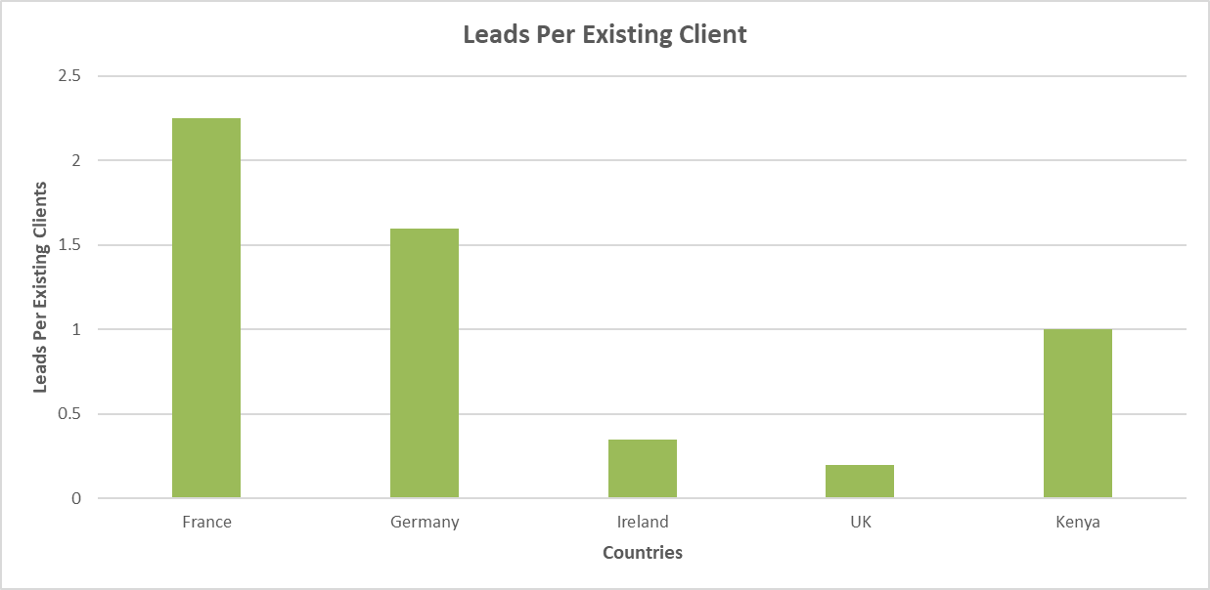
Where is organic growth coming from?
Locations where EnterpriseGoose have established clients are generating new organic leads.
France (2.25) and Germany (1.60) generate the most leads per existing client than the UK and Ireland.
Reputation and referrals are generating the most leads
These locations represent untapped market potential
Based on Leads_2026 and clients data

Slide 9
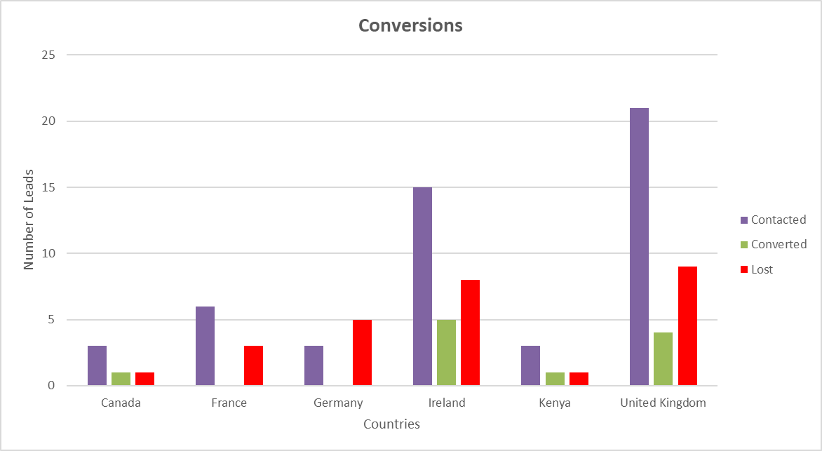
Where is outreach succeeding in 2026?
Ireland leads with 5 conversions from 28 leads (17.8%)
UK generates most leads (34) but converts at only 11.7%
Kenya shows their strongest conversion rate at 50% from 6 leads.
EnterpriseGoose should consider increasing outreach in Kenya as a growth opportunity.

Slide 10
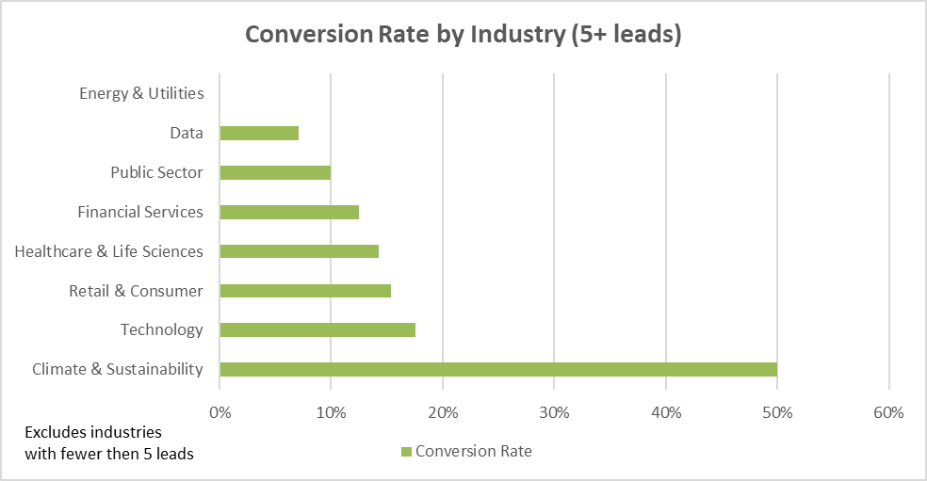
Conversion rates by industry
Conversion rates are highly inconsistent across industries.
Climate & Sustainability shows the strongest reliable conversion rate at 50% from 10 leads. In contrast, industries such as Data has 14 leads with a 7.14% conversion rate and Energy & Utilities has 8 leads with a 0% conversion rate performing significantly below average.
EnterpriseGoose's services resonates more strongly with certain industries than others.
They should focus outreach efforts on Climate & Sustainability and Technology industries where conversion rates are strongest.

Slide 11
Which Industries Use Our Services the Most?
Strongest Demand:
Financial Services
Retail & Consumer
Public Sector
Healthcare & Life Sciences
Technology & SaaS
Shows the highest project counts, indicating strong engagement and repeat business

Slide 12
Services Popularity & Profitability Summary
Most Popular Services:
Management
Logistics
Cybersecurity Development
The three making up the most share of completed projects, indicating strong client demand and potential areas for continued investment
Logistics and Management generate the highest total revenues
Cybersecurity Development has high value per project

Slide 13
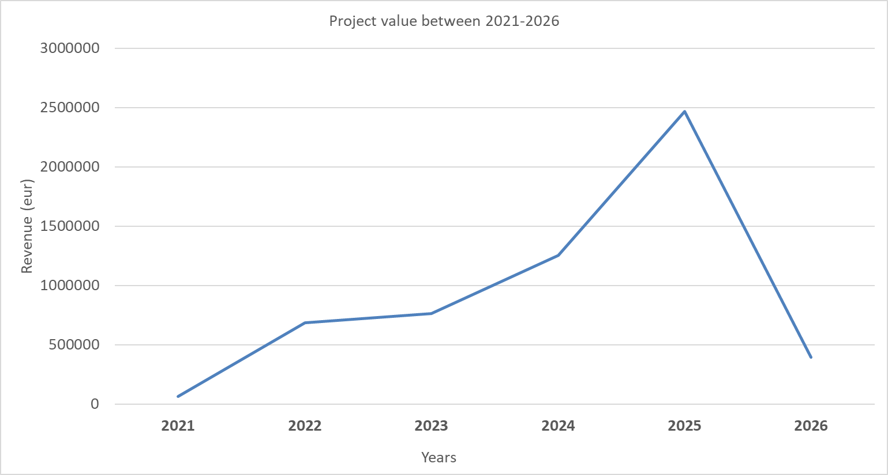
Sales Trends
Total revenue 2021-2026: €505,879
Surge in consultations in 2025, 167 projects in total = €246,6057
Projects in 2026 still ongoing so total revenue TBC

Slide 14
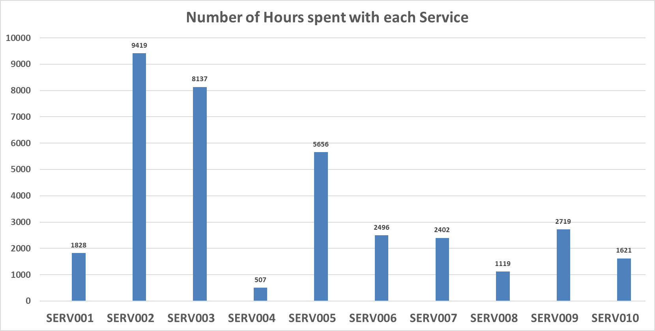
Service Revenue
Average number of hours sold across all services is 3,590.4hrs.
Highest amount of hour sold: Logistics
Lowest revenue: Film & TV

Slide 15
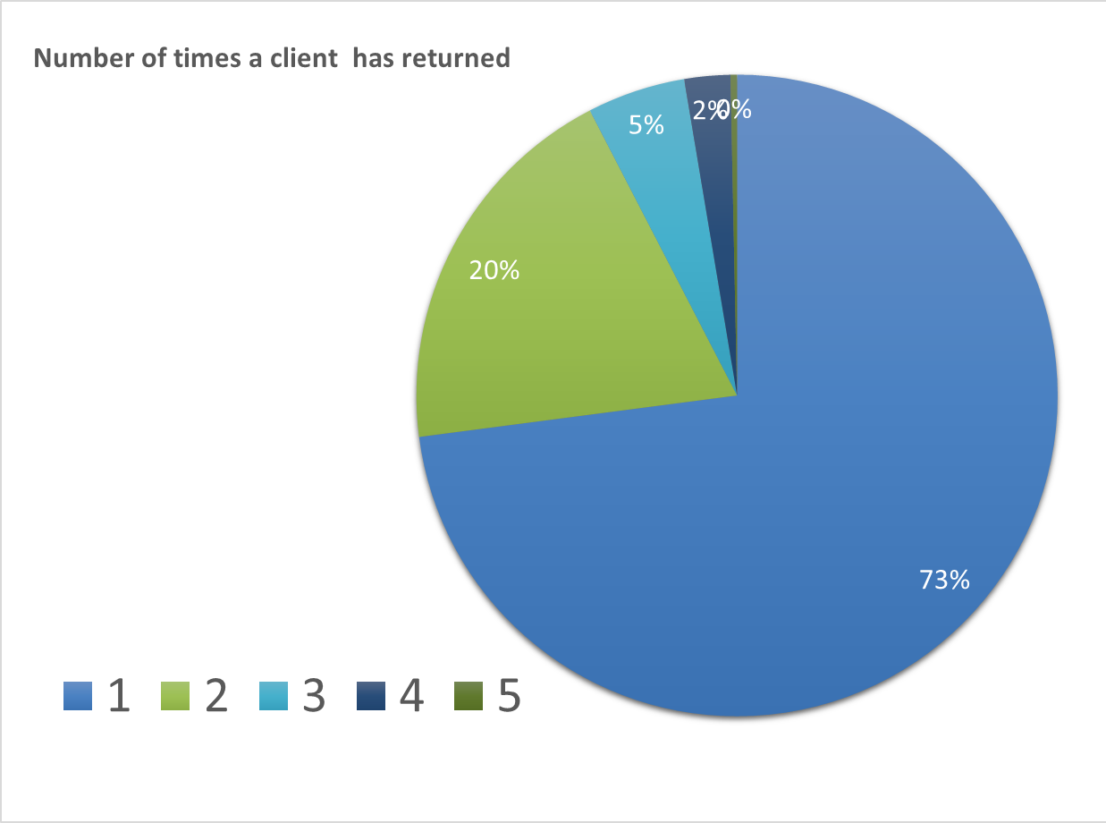
Client Retention Rates
1.38 Average returns per client
221 clients worked on 1 project
82 companies had 2 or more projects
Financial services have clients with the highest volume of returns
CLNT0001 highest number of projects with EG
 | year | Onboarding fee
 | 2021 | 250
 | 2022 | 300
 | 2023 | 380
 | 2024 | 450
 | 2025 | 510
 | 2026 | 510

Slide 16
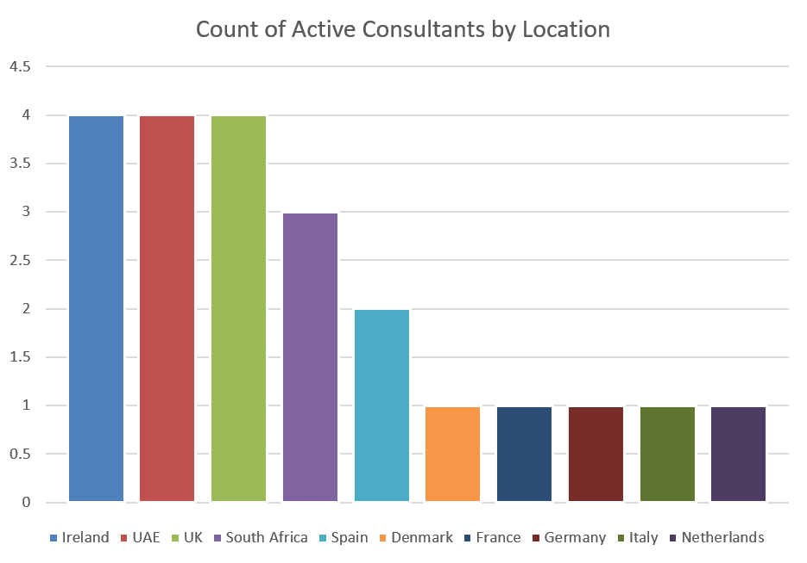
Consultants: Location and Time Employed
Most based in UK and Ireland
UAE brought on in the last 6 months
Top consultant performance are those based in Ireland and UK but also Spain and France
Average of 1211 hours billed across all consultants, low of 59, high of 4580
95.8 hours per project billed average

Slide 17
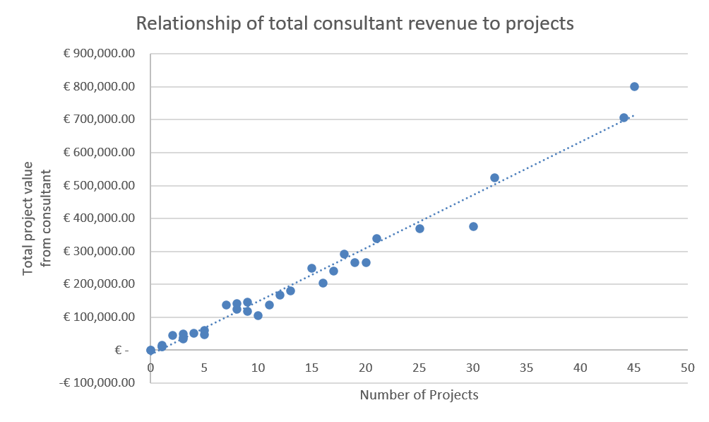
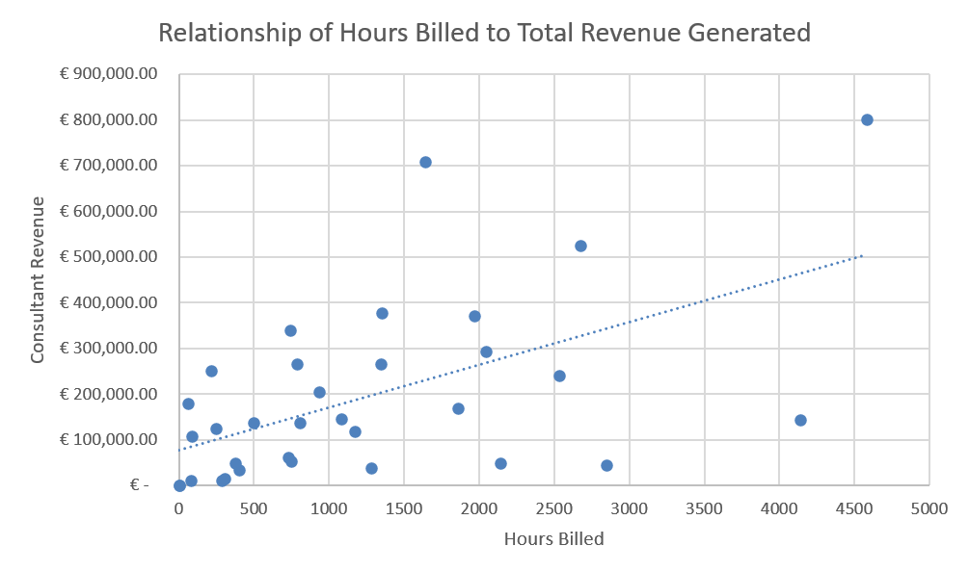
Revenue Earning and Hours
Top 6 consultants contributed €3,122,452 of total project revenue
Consultant value average varies between €9,470.20 and €22,914.50
Connection of hours billed and revenue generated not as strong
Consultants taking on services outside main specialisms

Slide 18
Conclusion

Slide 19
Conclusion
Clients: Industry with the highest number of clients is from the financial services sector. Additionally, clients in that sector have the highest retention rates and are more likely to be offered SERV002 than any other client industry.
Consultants: Location is important but not as strong a factor for hours spent on project. High revenue tied to a small number of consultants. Large deviation between hours billed and amount of revenue generated
Leads: France and Germany have the highest organic leads per clients suggesting organic reach and an untapped market. They should expand aggressively in France, Germany and Kenya targeting climate and sustainability clients as they represent the highest conversion potential internationally.
Sales Trends: Revenue has rapidly increased since 2021, 2025 earning the highest amount of income, 2026 may experience a similar outcome by the end of the year

Slide 20
Recommendations
Focus:
Top performing industries to maximise revenue and client retention
Improve:
Low-profit services through pricing, efficiency, or repositioning
Invest:
High-demand services and to strengthen competitive advantage

Slide 21
Q&A

Slide 22
Thank You For Listening

